Slide 1
Embedded System Final Project Intelligent Security Box
吳建翰、周子浩、張喬善

Slide 2
Project Revisited
To design a security box with a servo motor.
To handle NFC detection and web socket data transmission.
To design a backend to store user information.
To design a communication robot sending unknown-user warnings.

Slide 3


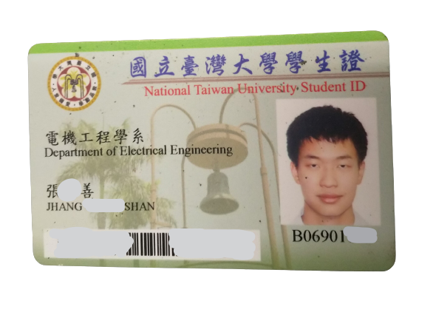
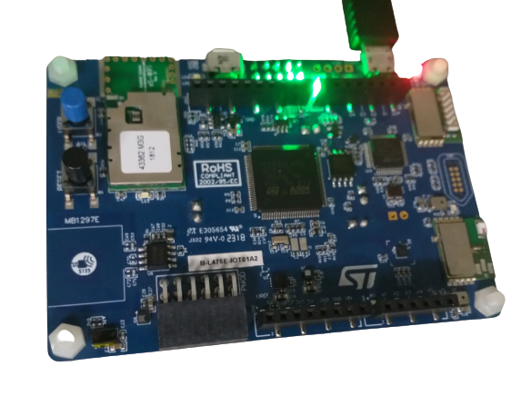


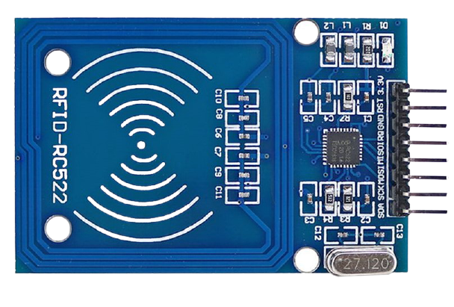
Heroku_1
Heroku_2
Server
Notes:
Problems about Heroku
different port when we use server and client
only one port at the same time

Slide 4
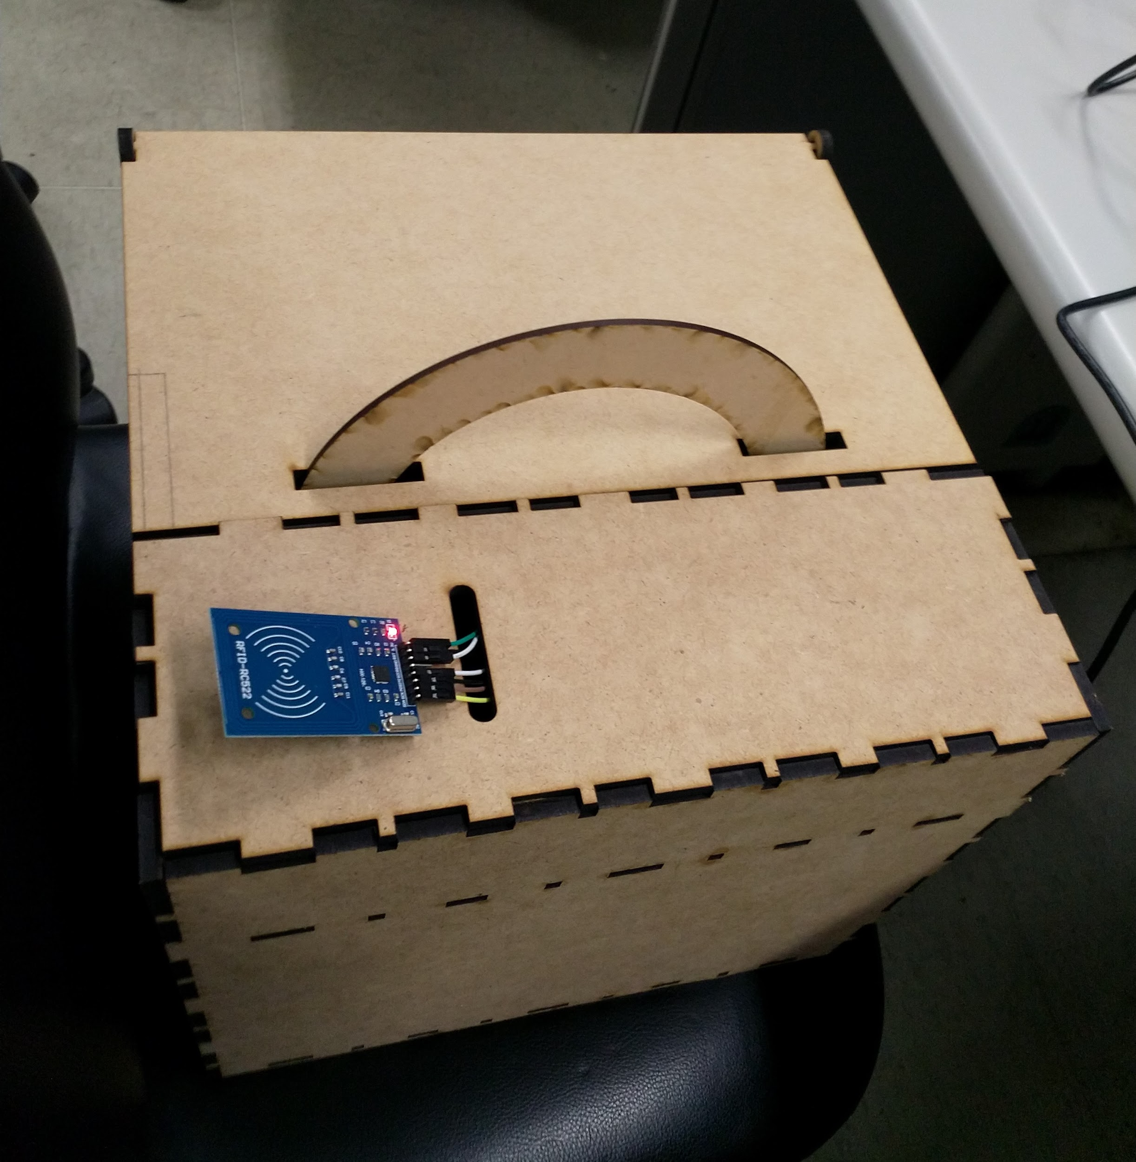
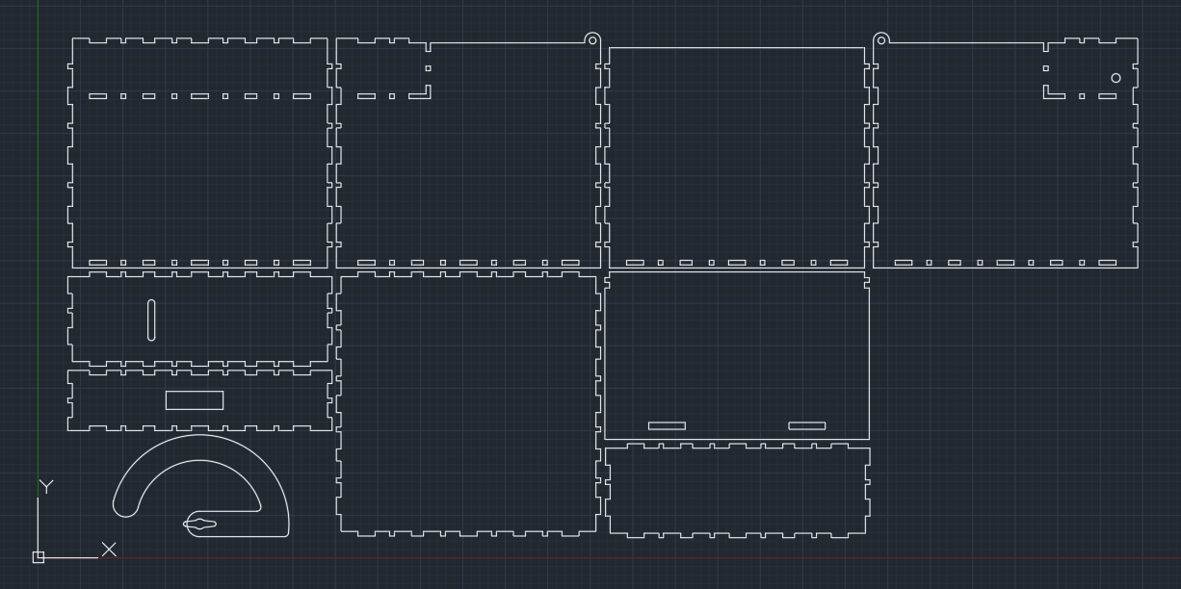
Wooden Box
Produced with laser cutting.

Slide 5
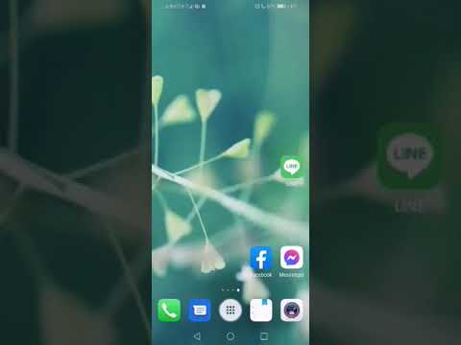
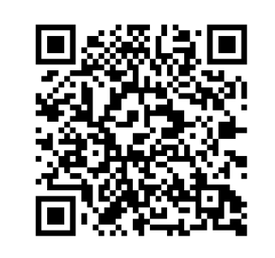
Linebot

Slide 6
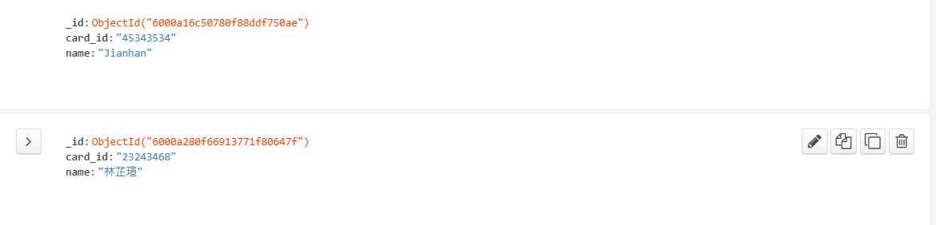
Backend
Notes:
Problems about Heroku
different port when we use server and client
only one port at the same time

Slide 7
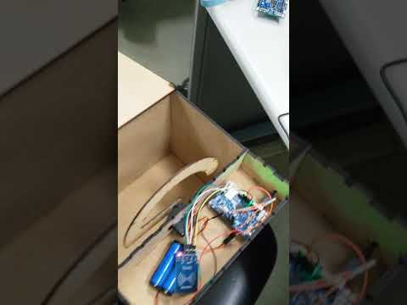
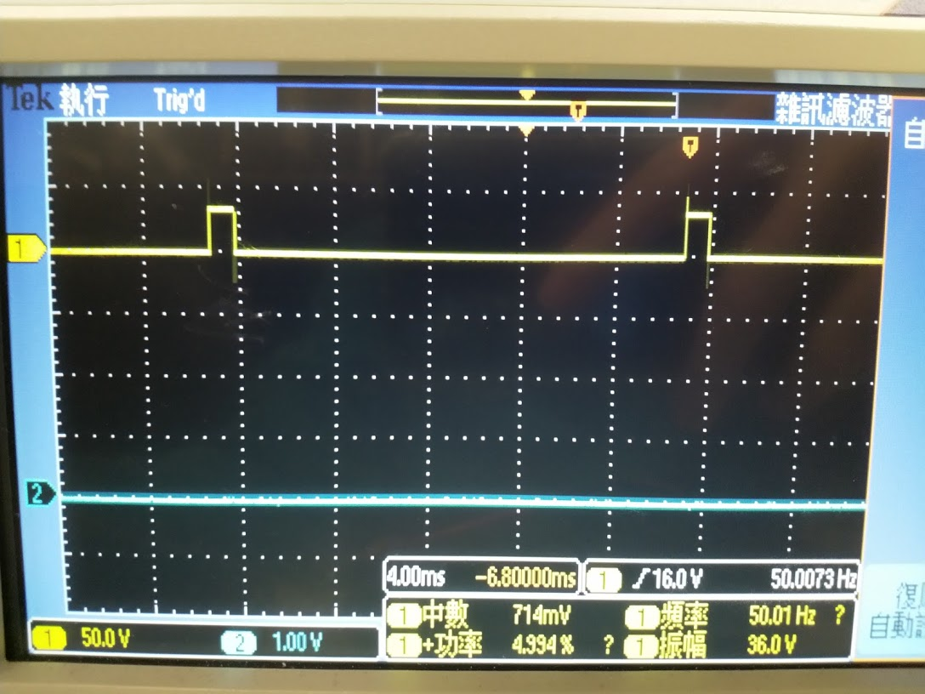
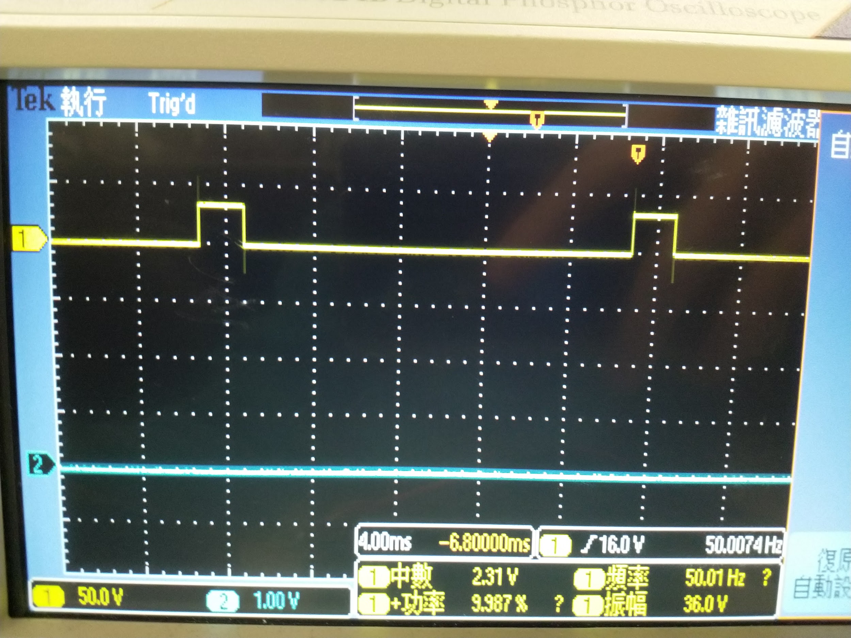
NFC & Motor

Slide 8
Thank you for your time.

